Slide 1
LINEAR APPROXIMATIONS AND DIFFERENTIALS
One of the beauties of Mathematics is that it is able to provide help in all sorts of different situations and to all sorts of people. Today we will learn how the two distinct groups of people listed below profit from the use of Mathematics. The two groups are:
Those morons in the Flat Earth Society.
The (unfortunately) numerically challenged.
As usual, the same Math will help both.
Notes:
, …

Slide 2
The Mathematics is based on the observation that
“close to the point of tangency a curve is very near the tangent.” Here is an illustration:
If your means of long distance vision are limited, you may see just the central portion, that is
This helps explain the Flat Earth folks.
In fact, looking at the red statement above, we see two words that are somewhat vague:
Close (how close is close?) and
Very near (how near?)

Slide 3
The next figures show that “close” and “near” depend heavily on how “curvy” the curve is at the point of tangency.
Some of you will study “curvy” in your junior or senior years, depending on your major.
One thing is clear: if the “curvy” is too sharp we lose the notion of tangent, so the statement
“close to the point of tangency a curve is very near the tangent” does not even make sense.

Slide 4
The four curves shown show how important “curvy” is to determine what “close to the point” and “near the tangent” may mean. Then we’ll look at a corner.
Not curvy at all, Flat Earth people rule !
But …

Slide 5
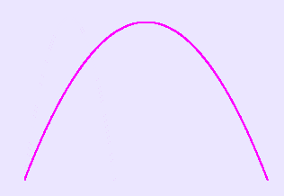
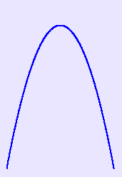
curvy
curvier
curviest
And finally

Slide 6
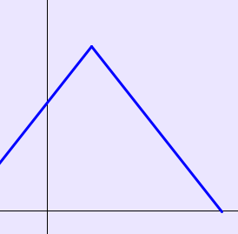
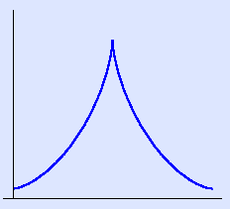
Worst case scenario ….. No tangent!
a corner
or even worse
a cusp

Slide 7
Let’s see what useful something we can get out of the red statement. You have a function
and a point on its graph.
The equation of the tangent line to the curve, with point of tangency is
and better yet
Put the equation of the curve and of the tangent next to each other, you get

Slide 8
(*)
Suppose you are asked to compute
(of course without a calculator, as in an exam!)
What do you do?
If you observe that and
life gets easy, because becomes
.Choose . Then

Slide 9
(*) becomes
And indeed, if “close to the point of tangency a curve (the bottom) is very near the tangent (the top)” then I can use either to do my calculations, and the top is easier, I get

Slide 10
I know
So I get
(your calculator will give you
Let’s formalize all of this:

Slide 11
Definition. Let be differentiable at
. The equation
Is called the
linear approximation or
tangent line approximation of at .
The linear equation
(the equation of the tangent line !) is called the
linearization of at .
Let’s look at a picture

Slide 12
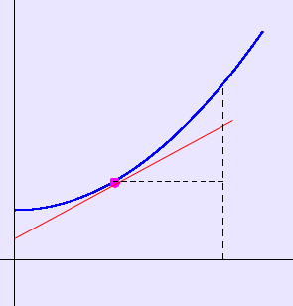
Here is a nice curve with its tangent line:
We put on some notation:

Slide 13
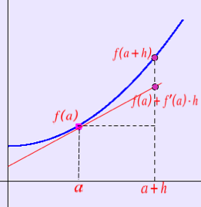
Let

Slide 14
The distance from to (OK, it’s )
determines both the quantity
and the quantity
In case 1 we denote the distance and the quantity .
In the second we call the distance (and name it the differential of ), and denote the quantity by and call it the differential of .

Slide 15
So we have:
vertical displacement along the curve (hard to compute)
vertical displacement along the tangent (easy to compute)
horizontal displacement.
the difference quotient
the equation of a the tangent

Slide 16
We get the very beautiful formula
(don’t be mesmerized by it, it’s just the definition of derivative in fancier clothes!)
One last device (due to Prof. Pilkington). When doing problems in linear approximations use the table below
Fill in all columns and GO !!
Notes:
Y = X cube , delta x = 0.5, x=2
34, p. 188 (paint ½ sphere

